Slide 1

Efficient Energy Tracking and Monitoring in IoT Enabled Smart Homes Using MQTT Protocol
Team Members:
I. Sai Kumar
Ch. Joshna
S. Jyothika
Project Guide:
Mr. R. Ashok
Sr. Assistant Professor
Dept of CSE

Slide 2
Abstract
The “Efficient Energy Tracking and Monitoring in IoT Enabled Smart Home Using MQTT Protocol" is a cutting-edge IoT solution designed to transform traditional households into intelligent, energy-efficient living spaces. Leveraging the powerful ESP32 microcontroller as the central hub, this system integrates multiple control mechanisms, including manual switches, MQTT-based remote control, and real-time energy monitoring. The project focuses on providing seamless control over home appliances while offering users detailed insights into energy consumption patterns.
By integrating cloud-based data logging through ThingSpeak and MQTT protocols, the system ensures reliable communication and analytics for energy usage and device management. The local LCD interface delivers instant feedback, enhancing accessibility and user experience. The combination of manual and automated control empowers users to operate appliances flexibly, catering to both tech-savvy and traditional preferences.

Slide 3
Introduction
The rapid rise in automation has led to increased electricity consumption in modern households. Traditional home systems lack the intelligence and flexibility to optimize appliance usage and reduce energy waste.
The depletion of fossil fuels and rising energy costs have made efficient energy management a pressing concern. Smart Home Energy Management Systems (SHEMS), powered by IoT, can monitor, control, and optimize power usage in real time.
By combining manual switches, and mobile app control, we aim to provide a versatile and user-friendly solution for managing both smart and non-smart home devices. Our system also works smoothly with your current home setup, making it easy to upgrade.
This project aims to design a cost-effective, scalable, and intelligent system using:
ESP32 microcontroller
ThingSpeak for energy monitoring
Node-RED for control interface

Slide 4
Objectives
Real Time Energy Monitoring:
Real-time tracking of power usage and energy consumption for enhanced energy efficiency.
Automation and Control:
Designing the system to control traditional non-smart appliances using IoT technology.
Data Logging and Visualization:
Uploading energy data and appliance states to ThingSpeak for analytics. Providing an intuitive LCD interface for instant feedback.
Ensure Seamless Integration Across Platforms:
Develop a unified system architecture that allows seamless communication and control across various platforms

Slide 5
Existing Methods
Paper | Features and System | Limitations
Netinant, P.; Utsanok, T.; Rukhiran, M.; Klongdee, S. Development and Assessment of Internet of Things-Driven Smart Home Security and Automation with Voice Commands. IoT 2024, 5, 79-99. https://doi.org/10.3390/iot5010005 | Voice Command Integration, PIR Sensor-Based Intrusion Detection, Mobile Application Control | Dependence on Wireless Network Connectivity, Voice Recognition Authenticity
N. Prathima, P. Sai Kumar, SK. Lal Ahmed and G. Chakradhar,, “Voice Recognition Based Home Automation System for Paralyzed People”, International Journal for Modern Trends in Science and Technology, Vol. 03, Special Issue 02, 2017, pp. 101-106. | Voice-Controlled Home Automation wheel chair Control via Voice Commands Design Messaging System, Assistive Technology for Independence | Limited Functionality in Power Outages, Limited Device Compatibility, Initial Setup Complexity
S. Das, S. Ganguly, S. Ghosh, R. Sarker and D. Sengupta, "A bluetooth based sophisticated home automation system using smartphone," 2016 International Conference on Intelligent Control Power and Instrumentation (ICICPI), 2016, pp. 236-240, doi: 10.1109/ICICPI.2016.7859709. | Smart Home Automation, Arduino-Based, Android App Control, Device Control Bluetooth, Communication | Dependency on Cell Phone, Compatibility issues, Limited Processing Power, Prototype Limitation, Memory Constraints
M. S. Mahamud, M. S. R. Zishan, S. I. Ahmad, A. R. Rahman, M. Hasan and M. L. Rahman, "Domicile - An IoT Based Smart Home Automation System," 2019 International Conference on Robotics,Electrical and Signal Processing Techniques (ICREST), Dhaka, Bangladesh, 2019, pp. 493-497, doi: 10.1109/ICREST.2019.8644349. | Arduino UNO-Based System,Wi-Fi Connectivity via ESP32 Module, Edge and Fog Computing Architecture, Simulation and Hardware Prototyping | Limited Processing Power of Arduino UNO, Complex Setup for Edge and Fog Computing, Memory Constraints

Slide 6
Paper | Features and System | Limitations
Intelligent Scheduling of Smart Home Appliances Based on Demand Response Considering the Cost and Peak-to-Average Ratio in Residential Homes Nedim Tutkun 1 , Alessandro Burgio 2 , Michal Jasinski 3,* , Zbigniew Leonowicz 3 and Elzbieta Jasinska 4 | Smart Grid Integration, Metaheuristic Techniques, Feasibility for Wide-Range Applications, Repeated Execution | Complexity of Multi-Objective Optimization, Feasibility for Wide-Range Applications, Repeated Execution Requirement
Energy Prediction and Optimization for Smart Homes with Weather Metric-Weight Coefficients Asif Mehmood 1 , Kyu-Tae Lee 1,* and Do-Hyeun Kim 2 | Voice-Controlled Home Automation wheel chair Control via Voice Commands Design Messaging System, Assistive Technology for Independence | Limited Functionality in Power Outages, Limited Device Compatibility, Initial Setup Complexity
S. Das, S. Ganguly, S. Ghosh, R. Sarker and D. Sengupta, "A bluetooth based sophisticated home automation system using smartphone," 2016 International Conference on Intelligent Control Power and Instrumentation (ICICPI), 2016, pp. 236-240, doi: 10.1109/ICICPI.2016.7859709. | Hybrid Optimization Approach, Proactive Energy Optimization, Optimized Indoor Setting, Inclusion of Additional Weather Metrics | Complex Optimization Trade-offs, Hybrid Approach Complexity, Seasonal and Monthly Variations, User Adaptability
M. S. Mahamud, M. S. R. Zishan, S. I. Ahmad, A. R. Rahman, M. Hasan and M. L. Rahman, "Domicile - An IoT Based Smart Home Automation System," 2019 International Conference on Robotics,Electrical and Signal Processing Techniques (ICREST), Dhaka, Bangladesh, 2019, pp. 493-497, doi: 10.1109/ICREST.2019.8644349. | Edge and Fog Computing Architecture, Arduino UNO-Based System,Wi-Fi Connectivity via ESP32 Module, Simulation and Hardware Prototyping | Complex Setup for Edge and Fog Computing, Memory Constraints, Limited Processing Power of Arduino UNO,

Slide 7
Proposed Model
The Propose Advanced Home Automation is designed to offer a comprehensive and flexible home automation solution. It seamlessly integrates manual switches and a mobile application to control both smart and non-smart home appliances. The system is powered by the ESP32 microcontroller, which facilitates wireless communication and employs MQTT and HTTP protocols for reliable data transmission.The mobile application, along with web-based control developed using Node-Red, provides an intuitive and user-friendly interface for remote monitoring and appliance management. Additionally, real-time energy tracking is implemented using ThingSpeak, enabling users to monitor power consumption and optimize energy usage effectively.
Advantages:
🔹 Cost-Effectiveness
The system allows non-smart appliances to be controlled using smart plugs and relays, reducing the need for expensive smart device upgrades.
🔹 Accessibility
Designed to be user-friendly, the system ensures that individuals of all ages and technical backgrounds can operate it effortlessly.
🔹 Enhanced User Experience
The LCD display provides real-time feedback on energy consumption, improving usability.
The system supports remote control and monitoring, making it more convenient for users to manage their home appliances from anywhere.
.

Slide 8
Process of Project
1. Initialization - The system initializes by setting up required parameters, including Wi-Fi, MQTT, and sensor conFigureureurations.
2. Data Collection from Appliances Network - The ESP32 collects real-time data from connected appliances.
3. Data Verification - If data is received, it is processed further; otherwise, the system waits for new data.
4. Display Data on LCD - The collected data is displayed on the LCD screen for local monitoring.
5. Data Transmission to EMS - The data is sent to the Energy Management System (EMS) for logging and analysis.
6. User Input Verification - If user input is detected, the corresponding action is executed; otherwise, the system continues monitoring.

Slide 9
7. User Input Verification - If user input is detected, the corresponding action is executed; otherwise, the system continues monitoring. 8. Data Logging - The system maintains logs of user interactions and energy data with date and time stamps for historical analysis.

Slide 10
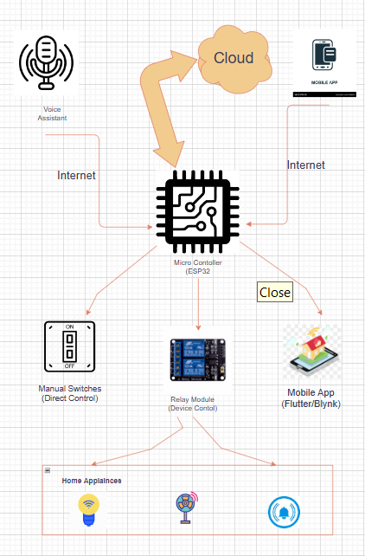
Architecture

Slide 11
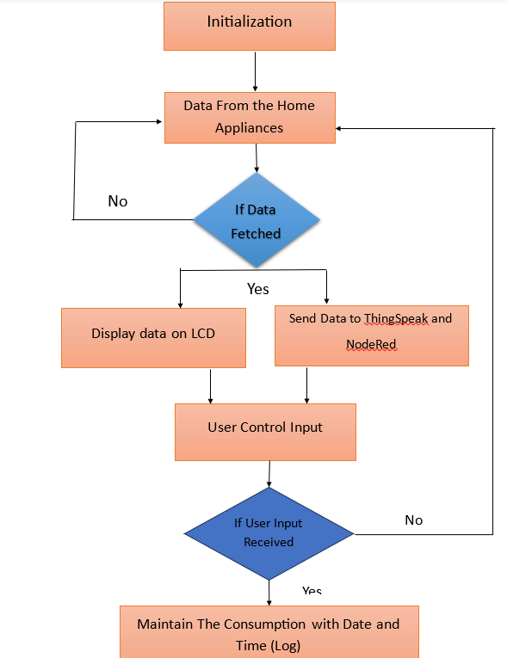
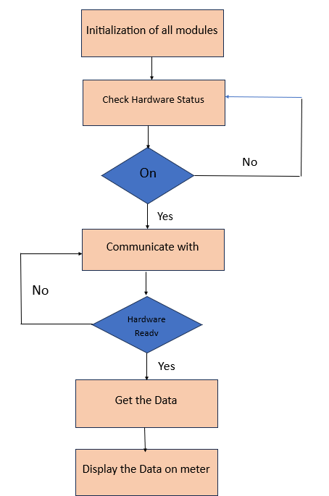
Flow of Project

Slide 12
System Components
ESP32 Microcontroller: Acts as the central hub for managing communication between devices.
Relays Module: Enable control of non-smart appliances by connecting them to the ESP32.
3. Mobile Application: Developed using MQTT App , it allows users to control and monitor appliances remotely.
4. MQTT Protocol: Ensures efficient and reliable communication between the ESP32 and connected devices.
5. Manual Switches: Provide traditional control options, ensuring accessibility for all users.

Slide 13
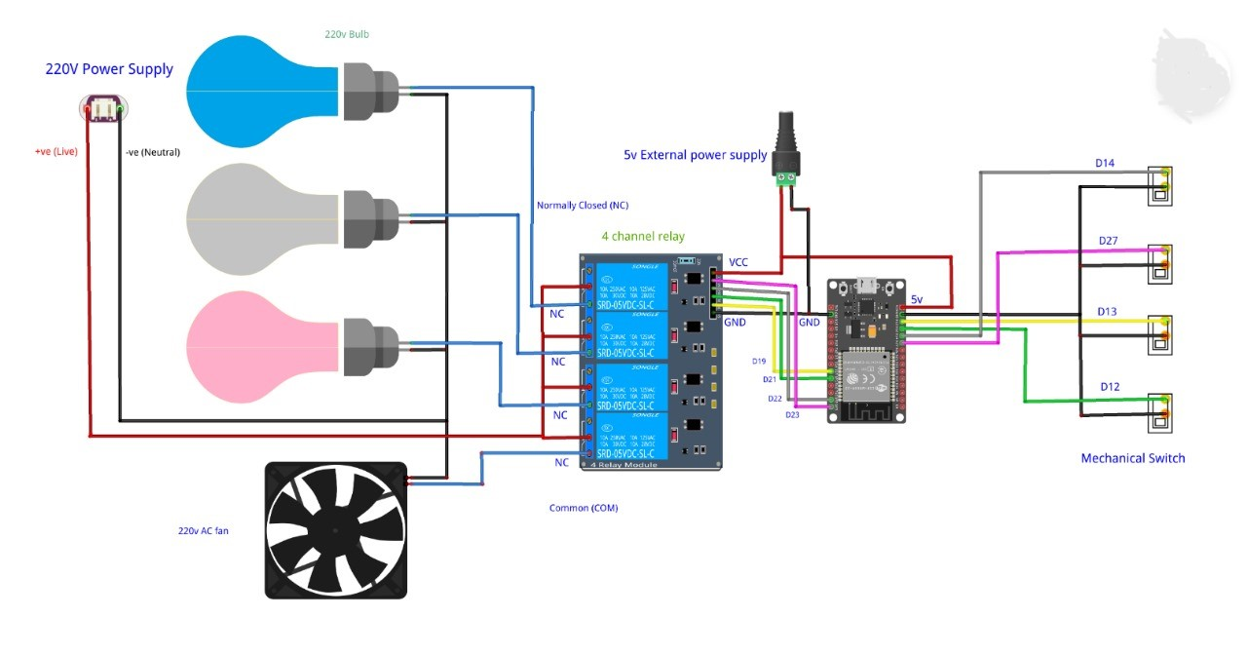
Circuit Diagram

Slide 14
Implementation
Real-Time Energy Monitoring:
Accurate tracking of voltage, current, power, and cumulative energy consumption.
Instant display on the LCD and periodic updates to ThingSpeak.
Multi-Device Control via MQTT:
Remote control of four appliances using HiveMQ.
Integration of manual and MQTT-based controls for enhanced flexibility.
FreeRTOS Task Segregation:
Dedicated tasks for energy monitoring, MQTT communication, GPIO control, and ThingSpeak updates
for efficient processing.
User Feedback Mechanism:
Visual feedback on an LCD for real-time monitoring of energy usage.

Slide 15
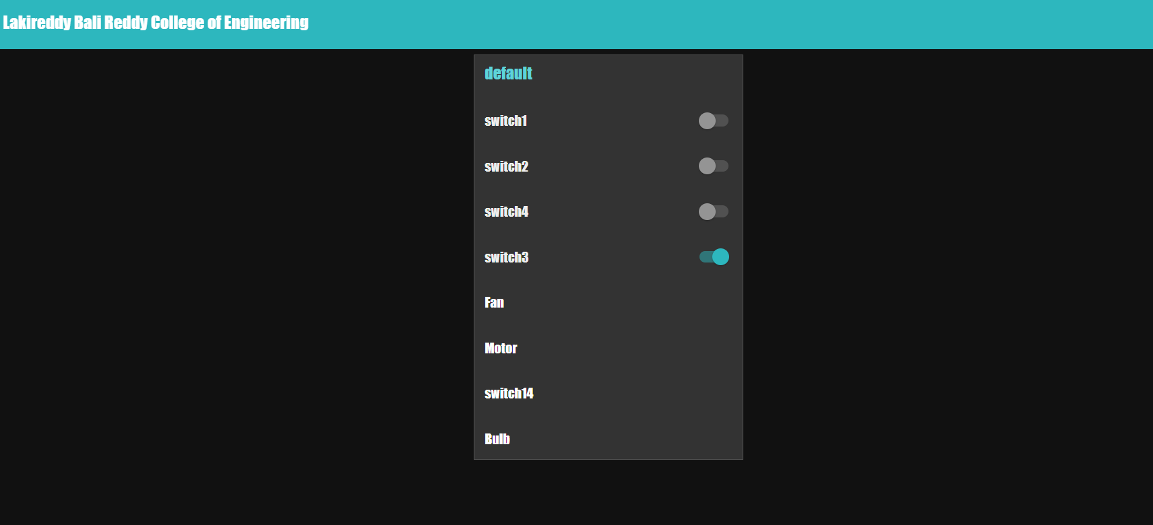
Programming Environment: Developed using Arduino IDE and FreeRTOS
for multitasking and for website creating we used Node-red
MQTT Topics: Configured for each appliance for individual control and status
updates.
Energy Data Logging: Periodic publishing of energy metrics to ThingSpeak for
further analysis.
Debouncing for Manual Buttons: Reliable detection of button presses to
prevent false triggers.

Slide 16
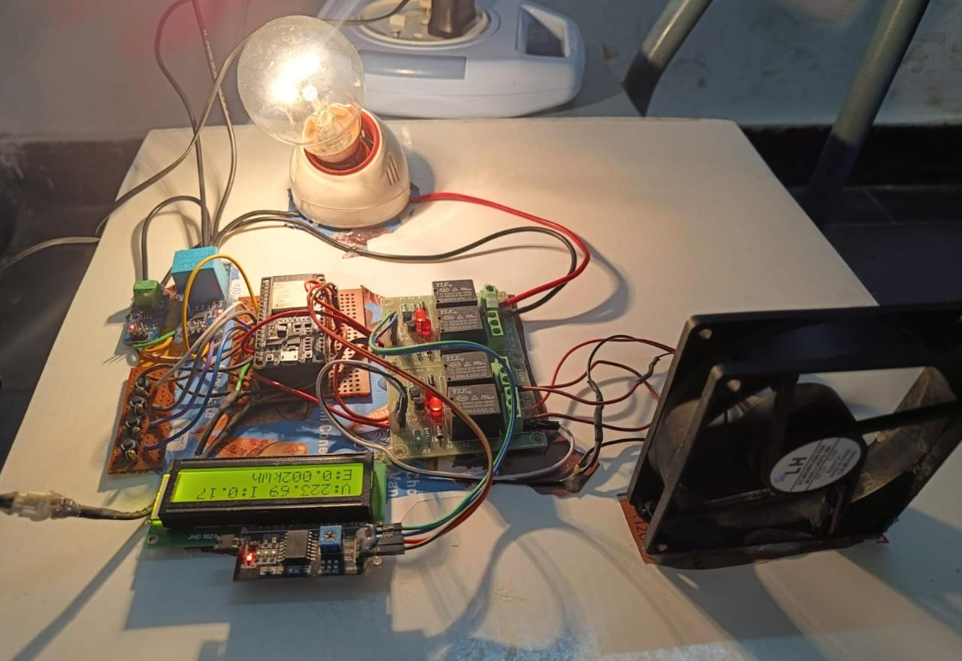
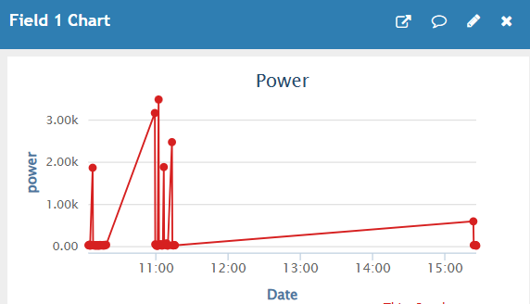
Results:

Slide 17
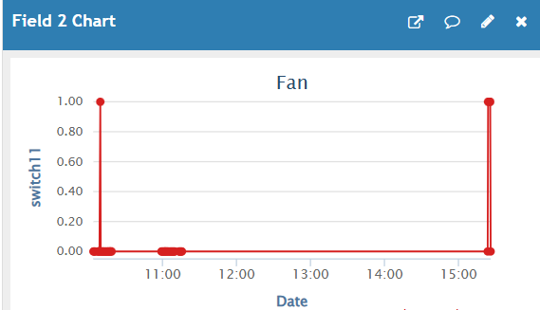
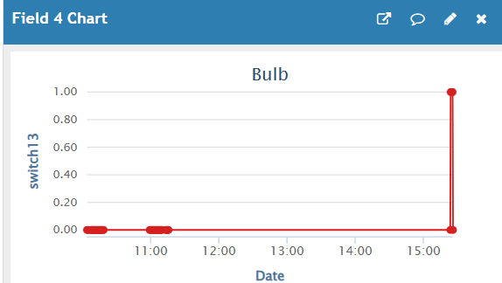

Slide 18
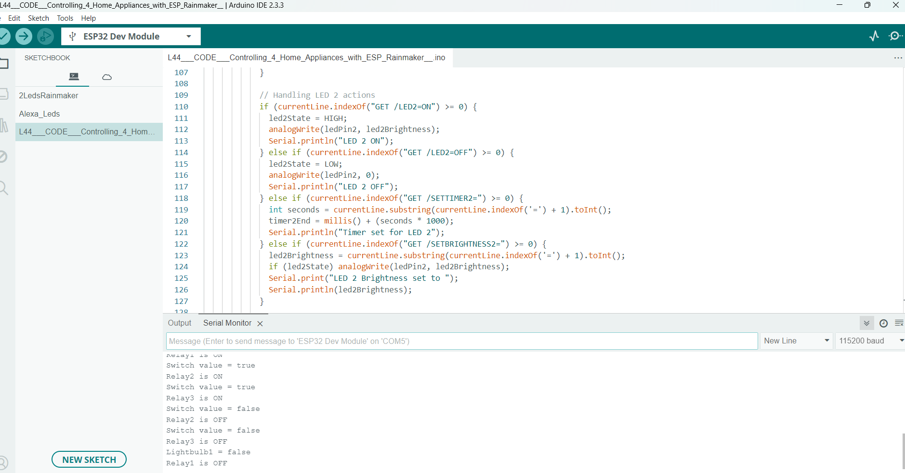
Arduino Uno Platform

Slide 19
Conclusion
This project demonstrates the potential of IoT in creating energy-aware, smart home environments. By combining automation with real-time energy tracking, it empowers users to make informed decisions about their energy consumption, paving the way for a more sustainable future. The flexibility and accessibility of the system ensure that it caters to the diverse needs of modern households, providing a robust foundation for future innovations in home automation.

Slide 20
Future Scope
To enhance system capabilities and meet evolving smart home standards, the following improvements are proposed:
AI-Based Predictive Automation: Integration of machine learning algorithms to forecast usage patterns and automate control accordingly. Smart appliance learning based on user habits
Enhanced Security Features: Incorporating MQTT over TLS/SSL for encrypted communication. User authentication and access control for web/mobile dashboards.
Mobile Notifications: Push alerts for abnormal energy usage, connectivity issues, or device malfunctions.
Renewable Energy Integration: Adding support for solar panels or battery storage systems to optimize renewable energy consumption.

Slide 21
Acknowledgments
I would like to express my sincere gratitude to the following individuals and institutions whose support was instrumental in completing this project:
Faculty Advisors and Project Mentors For their continuous guidance, technical insights, and encouragement throughout the development process.
Lakireddy Bali Reddy College of Engineering For providing the infrastructure, resources, and a collaborative environment essential for hands-on experimentation and innovation.
Open-source Communities and Developers Whose tools and libraries—especially Arduino Uno, Node-red, and ThingSpeak , documentations—played a vital role in implementation.

Slide 22

References
Candanedo, L.M.; Feldheim, V.; Deramaix, D. Data driven prediction models of energy use of appliances in a low-energy house. Energy Build. 2017, 140, 81–97. [Google Scholar] [CrossRef]
Mehmood, F.; Ahmad, S.; Ullah, I.; Jamil, F.; Kim, D. Towards a dynamic virtual iot network based on user requirements. Comput. Mater. Contin. 2021, 69, 2231–2244. [Google Scholar] [CrossRef]
Shafqat, W.; Malik, S.; Lee, K.T.; Kim, D.H. PSO based optimized ensemble learning and feature selection approach for efficient energy forecast. Electronics 2021, 10, 2188. [Google Scholar] [CrossRef]
Shaheen, M.A.; Hasanien, H.M.; Alkuhayli, A. A novel hybrid GWO-PSO optimization technique for optimal reactive power dispatch problem solution. Ain Shams Eng. J. 2021, 12, 621–630. [Google Scholar] [CrossRef]
Candanedo, L.M.; Feldheim, V. Accurate occupancy detection of an office room from light, temperature, humidity and CO₂ measurements using statistical learning models. Energy Build. 2016, 112, 28–39. [Google Scholar] [CrossRef]
Pranolo, A.; Mao, Y.; Wibawa, A.P.; Utama, A.B.P.; Dwiyanto, F.A. Robust LSTM with Tuned-PSO and Bifold-Attention Mechanism for Analyzing Multivariate Time-Series. IEEE Access 2022, 10, 78423–78434. [Google Scholar] [CrossRef]
Malik, S.; Shafqat, W.; Lee, K.T.; Kim, D.H. A Feature Selection-Based Predictive-Learning Framework for Optimal Actuator Control in Smart Homes. Actuators 2021, 10, 84. [Google Scholar] [CrossRef]
Malik, S.; Lee, K.; Kim, D. Optimal control based on scheduling for comfortable smart home environment. IEEE Access 2020, 8, 218245–218256. [Google Scholar] [CrossRef]
McKinsey on Smart Grid—SEDC, [online] Available: http://sedc-coalition.eu/wp-content/uploads/2011/06/McKinsey-10-08-05-Smart-Grid-Benefits.pdf.
X. Chen, T. Wei and S. Hu, "Uncertainty-aware household appliance scheduling considering dynamic electricity pricing in smart home", IEEE Trans. Smart Grid, vol. 4, pp. 932-941, Jun. 2013.
M. A. A. Pedrasa, T. D. Spooner and I. F. MacGill, "Coordinated scheduling of residential distributed energy resources to optimize smart home energy services", IEEE Trans. Smart Grid, vol. 1, no. 2, pp. 134-143, Sep. 2010.

Slide 23
Thank you

